Slide 1
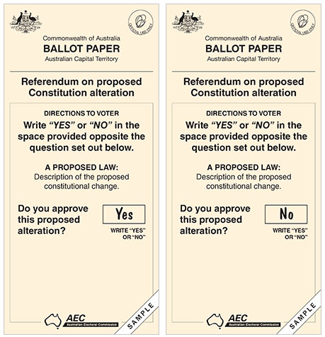
REFERENDUMS

Slide 2
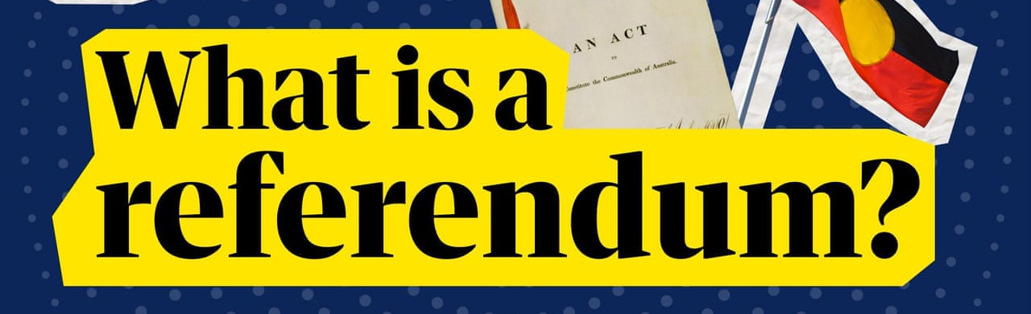
THE AUSTRALIAN CONSTITUTION
https://www.youtube.com/watch?v=wR5S2bCDSwM

Slide 3
Influences on the structure of the political and legal system
Swiss referenda process
A referendum is a direct vote by the people and used to make changes to the national constitution
It appealed to the ‘Founding Fathers’ so it became a feature of the Constitution. Section 128 includes the following:
Proposed law (change in wording) must be approved by an absolute majority in both houses in the form of a Bill
Referendum must be passed by the majority of voters nationally and the majority of voters in the majority of states (double majority)
If double majority is achieved the proposed law will then receive royal assent

Slide 4
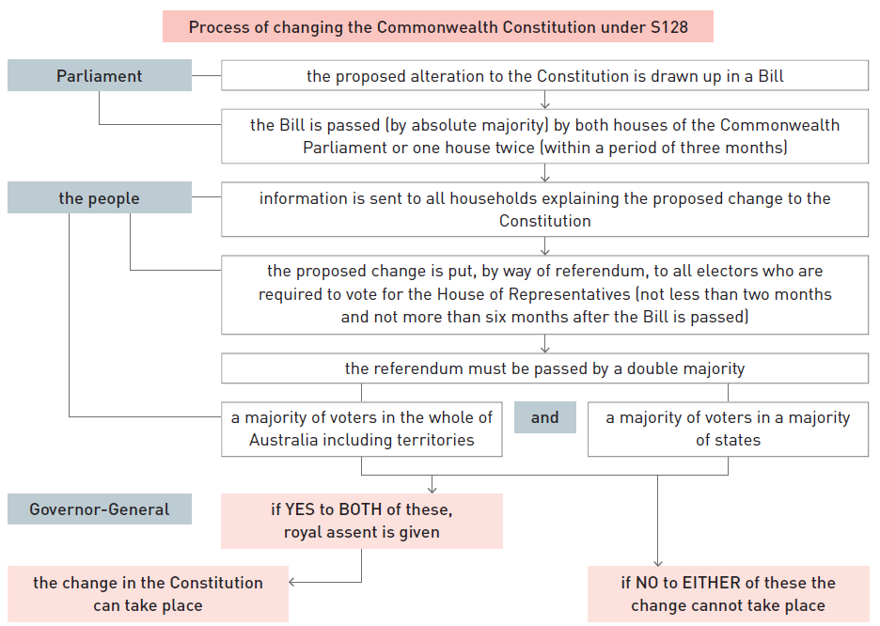

Slide 5
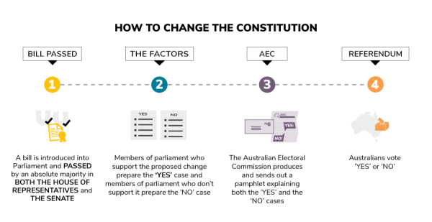

Slide 6
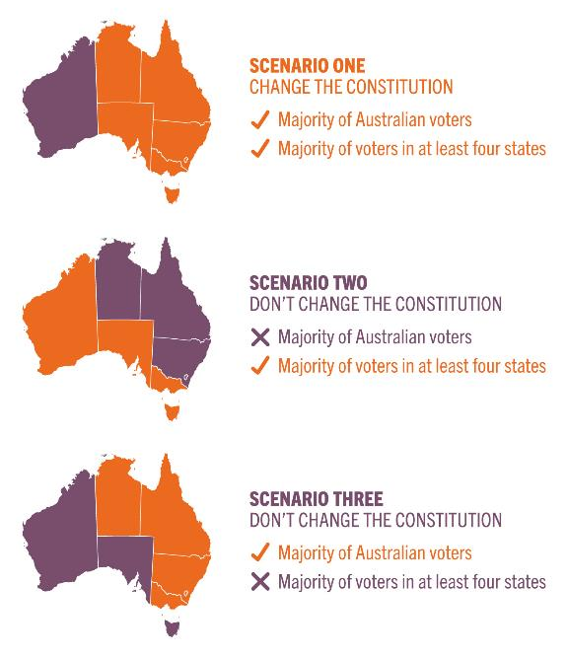
Double majority provisions
For a referendum to be successful:
Provision 1
The majority of voters in Australia must vote yes, AND
Provision 2
The majority of voters in the majority of states (four out of six) must vote yes
Important note:
Votes in territories are only included in Provision 1
Provision 2 protects the smaller states from being dominated by more populated states

Slide 7
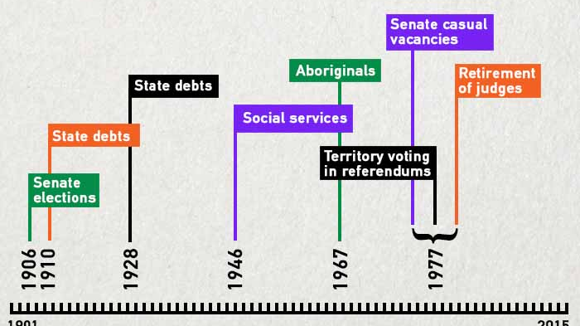

Slide 8

HOW DIFFICULT IS IT?
https://www.theguardian.com/australia-news/video/2022/dec/09/what-is-a-referendum-and-how-can-it-change-australia-news-glossary

Slide 9
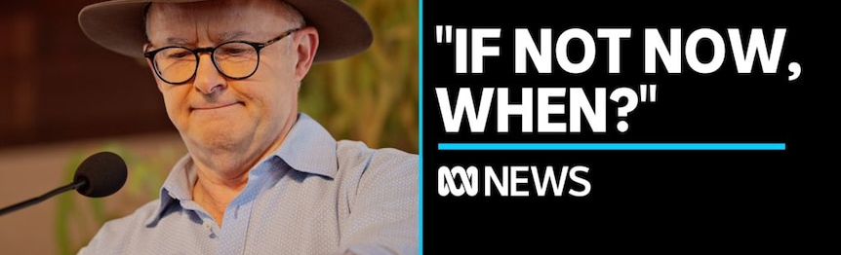
2023 Indigenous Recognition…??
https://www.youtube.com/watch?v=5gF6DqYH6FE&t=10s
Research what the referendum is proposing…
Albanese’s position? - https://www.abc.net.au/news/2022-07-31/what-is-an-indigenous-voice-to-parliament-and-uluru-statement/101285958

Slide 10
How would the Constitution change?
There shall be a body, to be called the Aboriginal and Torres Strait Islander Voice.
The Aboriginal and Torres Strait Islander Voice may make representations to parliament and the executive government on matters relating to Aboriginal and Torres Strait Islander peoples.
The Parliament shall, subject to this constitution, have power to make laws with respect to the composition, functions, powers and procedures of the Aboriginal and Torres Strait Islander Voice.

